Slide 1
Psychological Health

Slide 2
In the UK, mental ill health is the largest cause of disability, contributing 22.8% of the total disability burden, compared to cancer (15.9%) and cardiovascular disease (16.2%).
(Stoke on Trent City Council, 2024)

Slide 3

Introduction
Mental health is a state of mental well-being that enables people to cope with the stresses of life, realize their abilities, learn well and work well, and contribute to their community.
Many mental health conditions can be effectively treated at relatively low cost, yet health systems remain significantly under-resourced and treatment gaps are wide all over the world. Mental health care is often poor in quality when delivered. People with mental health conditions often also experience stigma, discrimination and human rights violations.
(World Health Organization, 2025)

Slide 4
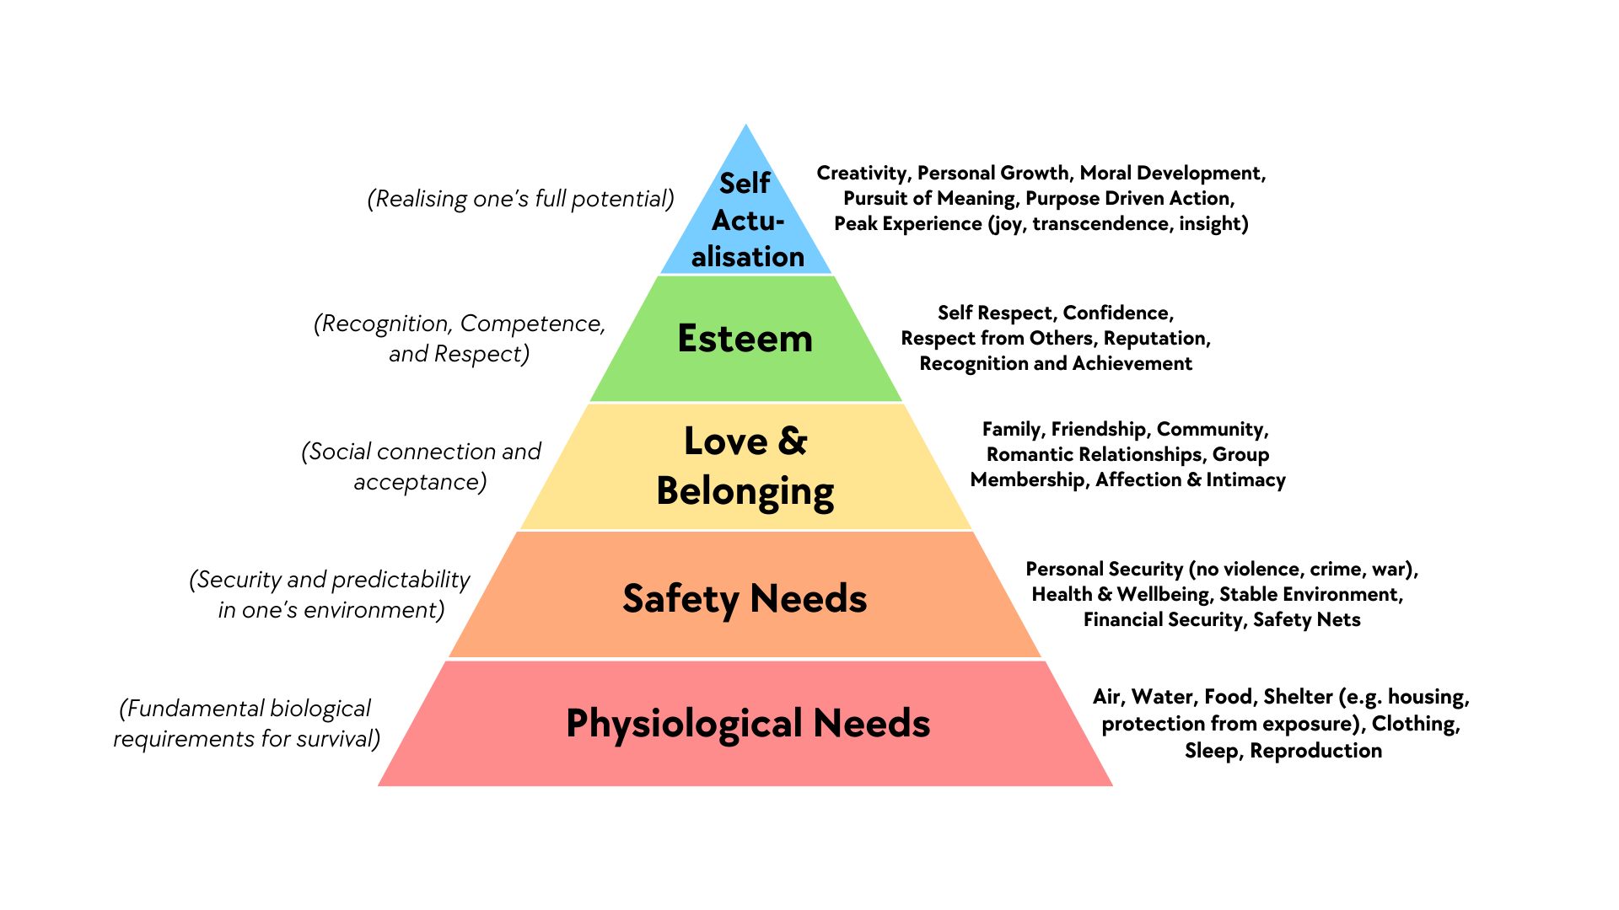
(Maslow, 1943)

Slide 5

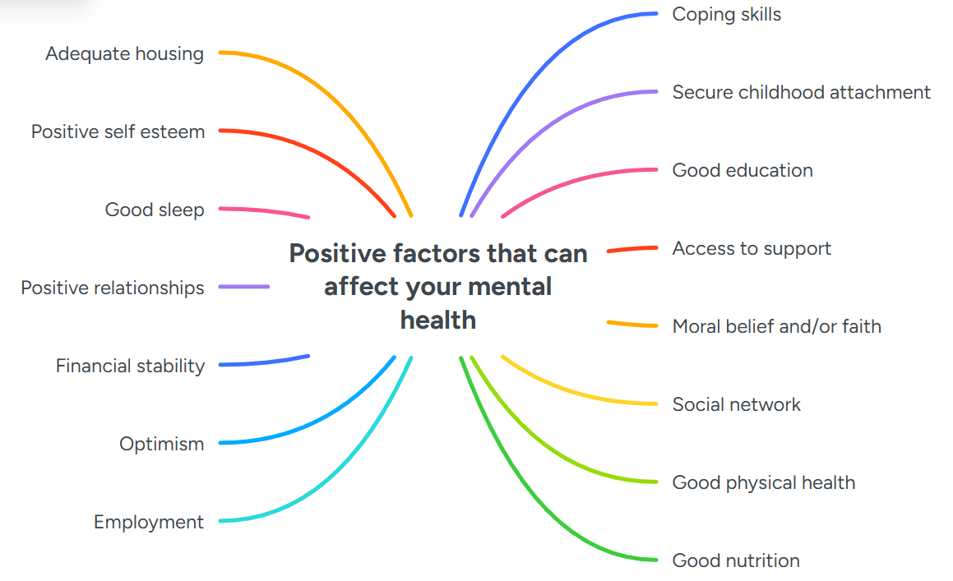
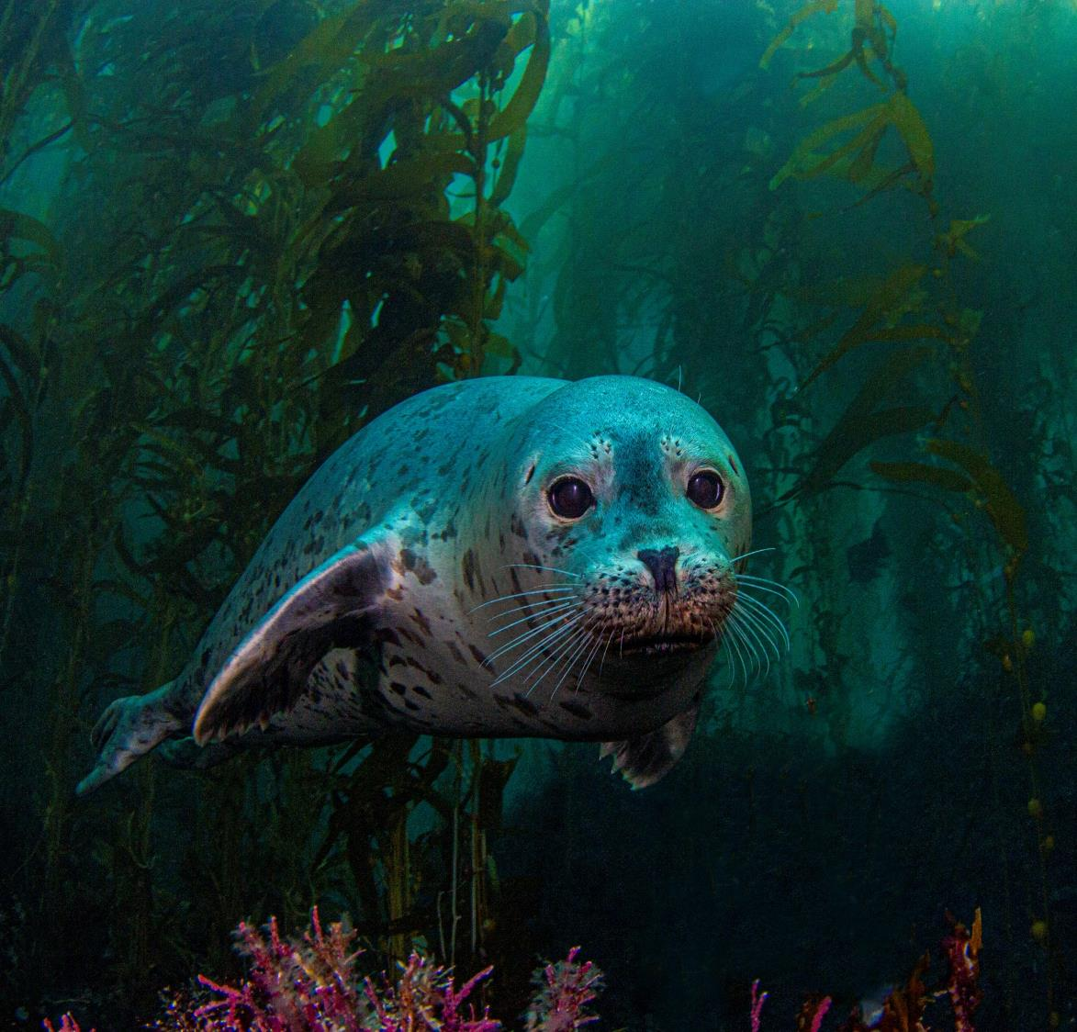
(Stoke on Trent City Council, 2024)

Slide 6

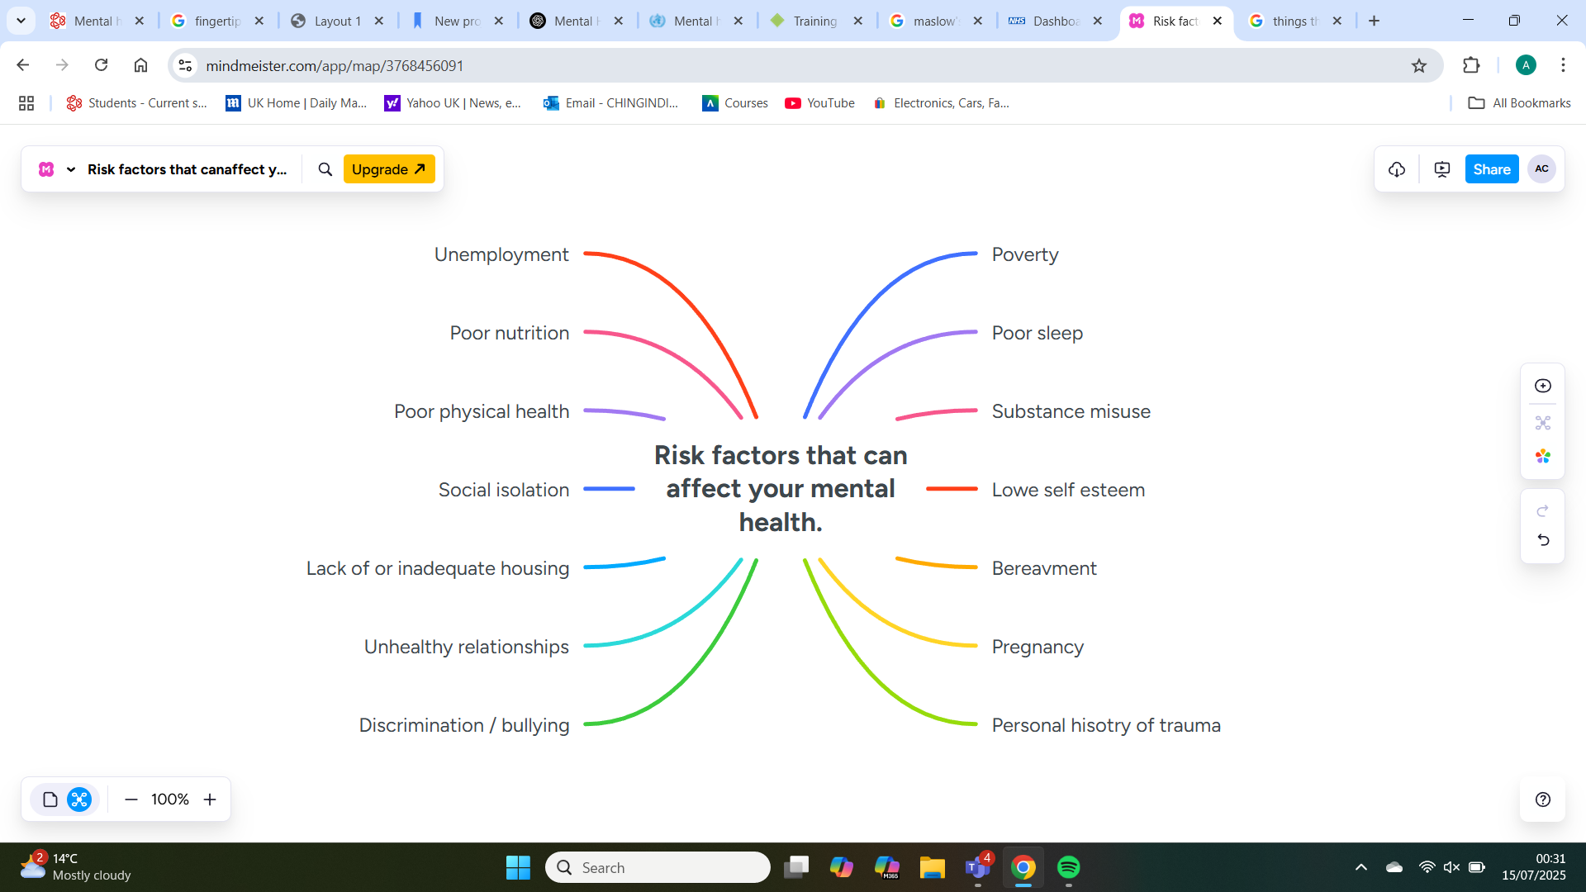
(Stoke on Trent City Council, 2024)

Slide 7
(Maslow, 1943)

Slide 8
Suicide and self harm are not mental health problems but are linked with mental distress. In the UK in 2022, 6,248 people took their own lives
(Department of Health and Social Care, 2025)

Slide 9
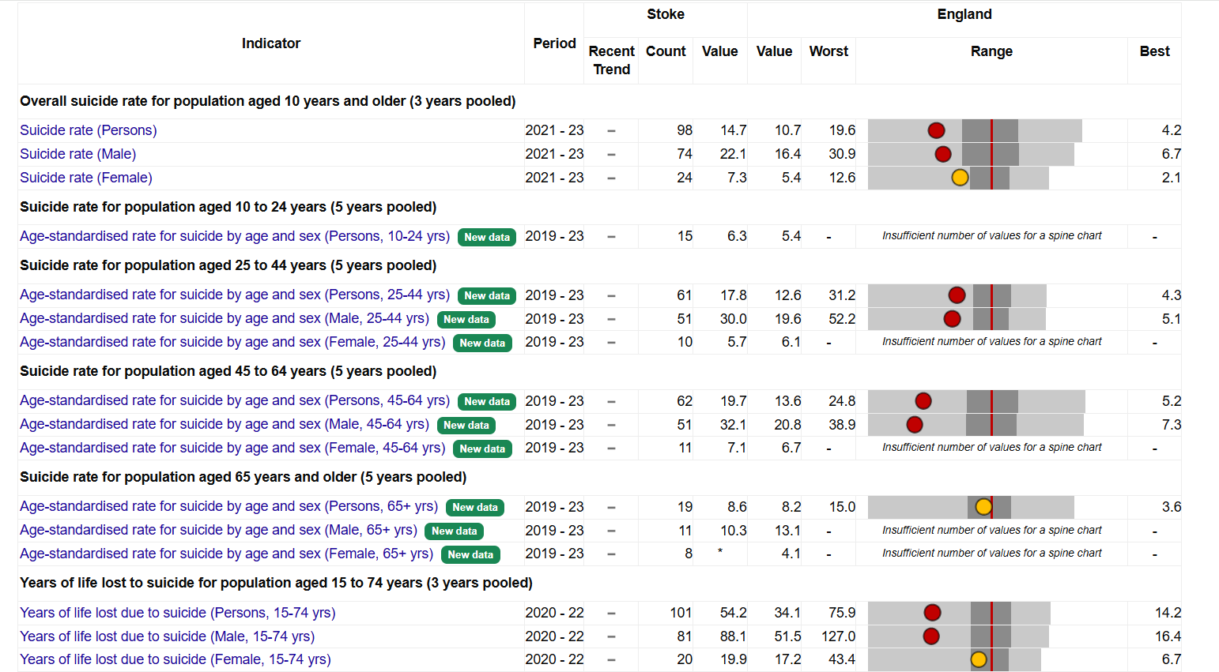

Slide 10
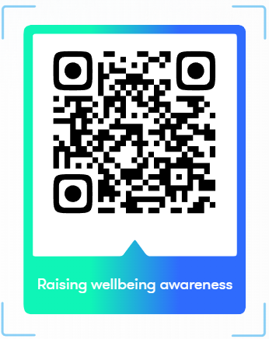

Slide 11
“They may forget what you said, but they will never forget how you made them feel.”
– Carl W. Buechner

Slide 12

Q & A

Slide 13
References
City of Stoke-on-Trent Council (2015). Support Services | Support Services | Stoke-on-Trent. [online] Stoke.gov.uk. Available at: https://www.stoke.gov.uk/info/20010/adult_care_and_wellbeing/377/support_services?utm_source=Facebook&utm_medium=social&utm_campaign=Orlo&utm_content=Mental+Wellbeing [Accessed 18 Jul. 2025].
Department of Health and Social Care (2025). Suicide Prevention | Fingertips | Department of Health and Social Care. [online] Phe.org.uk. Available at: https://fingertips.phe.org.uk/profile-group/mental-health/profile/suicide/ [Accessed 15 Apr. 2025].
Maslow, A.H. (1943). A Theory of Human Motivation. Psychological Review, [online] 50(4), pp.370–396. doi:https://doi.org/10.1037/h0054346.
Mental Health Foundation (2023). Suicidal thoughts: statistics. [online] www.mentalhealth.org.uk. Available at: https://www.mentalhealth.org.uk/explore-mental-health/statistics/suicidal-thoughts-statistics [Accessed 11 Jul. 2025].
Stoke on Trent City Council (2024). Stoke-on-Trent DPH Annual Report 2024 Stoke-on-Trent DPH Annual Report 2024. [online] Available at: https://www.stoke.gov.uk/download/downloads/id/2582/director_of_public_health_annual_report.pdf [Accessed 1 Jul. 2025].
World Health Organization (2025). Mental Health. [online] World Health Organization. Available at: https://www.who.int/health-topics/mental-health#tab=tab_1 [Accessed 1 Jul. 2025].

